Slide 1


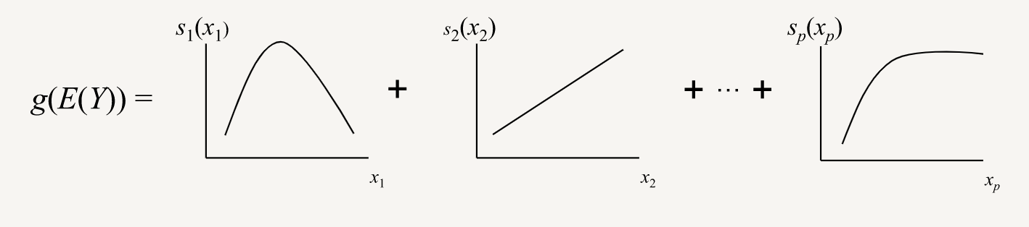
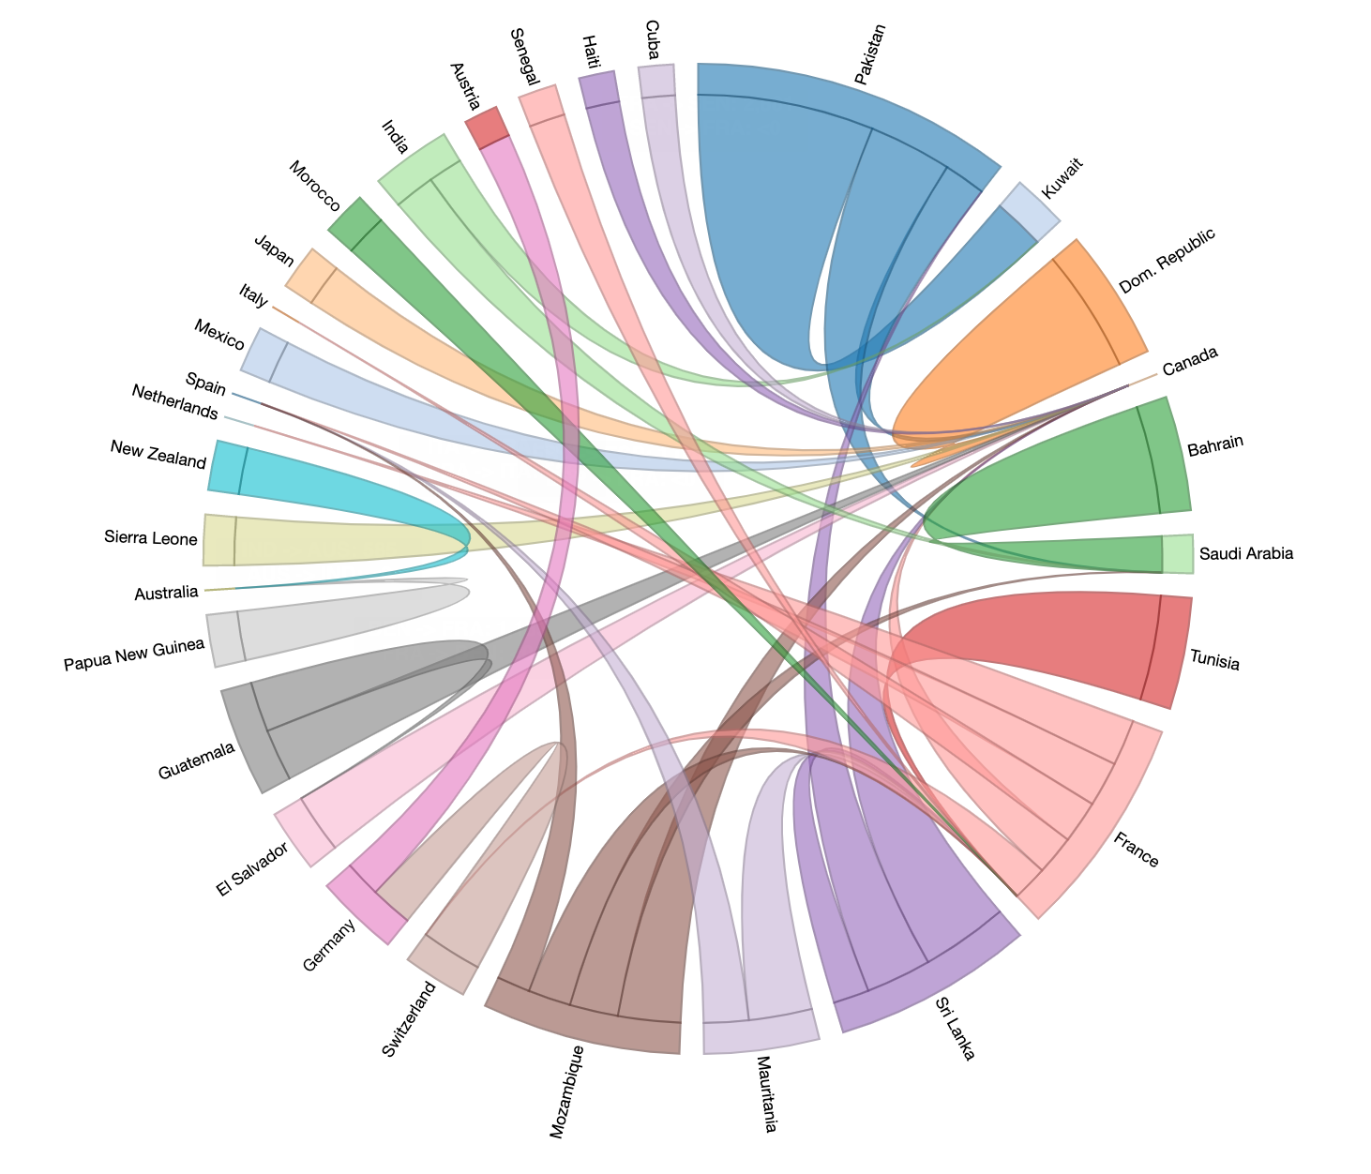
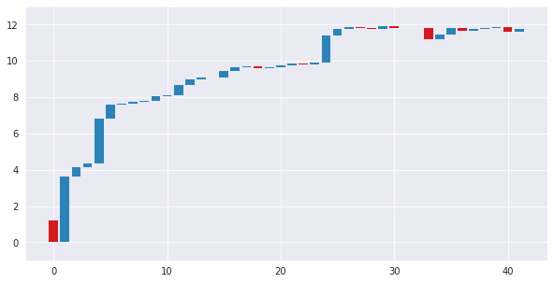
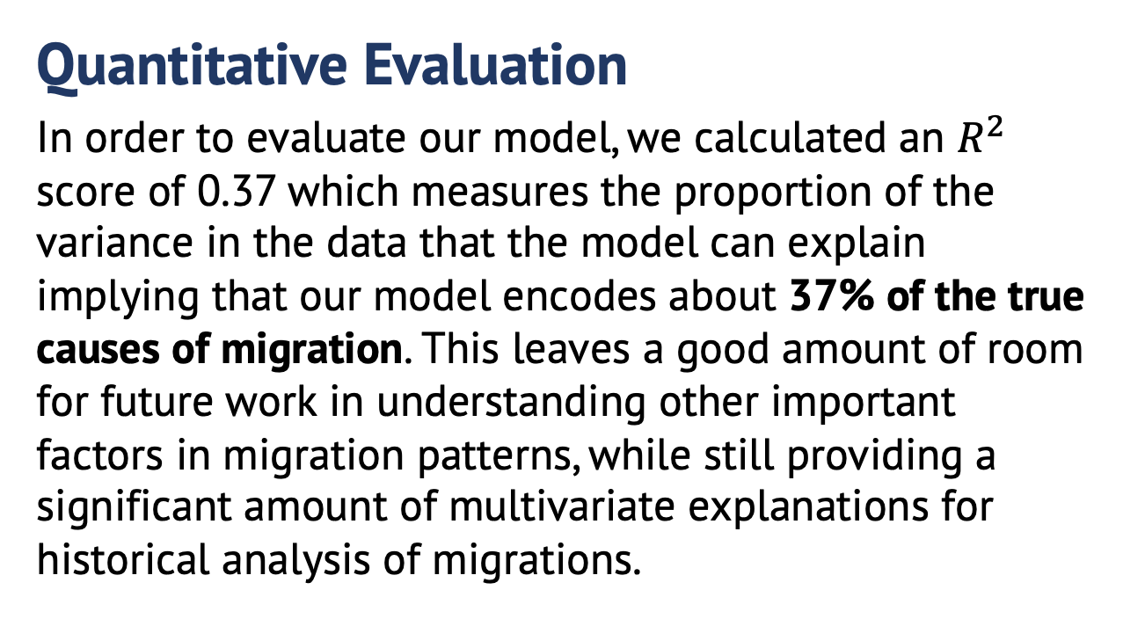
Estimating Impact of Climate
Change on Human Migration
Arjun Goyal, Austin Himschoot, Chitwan Kaudan, Lipi Shah, Frank Whitesell, Austin Wright
Demo our viz!
MOTIVATION
OUR APPROACH
Problem
The Intergovernmental Panel on Climate Change (IPCC) believes climate change is becoming a driving force of human migration and hypothesizes there will be 200 million climate migrants by 2050. We want to model the impact of climate change on global migration and develop an intuitive descriptive visualization of our model. We hope policy makers can use our tool to understand how different factors (i.e. demographics, economics, climate, trade, war) can impact migration to and from their countries.
Why modeling migration matters
If climate change has an impact on global migration, monitoring climate patterns can help countries anticipate flow of emigrants and immigrants
Migration is a transfer of resources, skills and manpower. If properly documented and visualized, it could benefit two countries in better policy making, curtailing on-going economic issues, enhancing globalization and foreign exchange with other nations
Aids a proper and even distribution of a nation’s wealth and resources
To understand impact of climate change on migration, we built a comprehensive model to estimate human migration. We pooled a list of common causes of human migration from previous work, trained a General Additive Model (GAM), and analyzed the predictive power of climate change.
What is a GAM?
General Additive Models (GAM) are a type of generalized linear model where “the impact of the predictive variables is captured through smooth functions which—depending on the underlying patterns in the data—can be nonlinear.” The relationship between each predictor variable and the response are modeled simultaneously by a non-parametric function during model estimation. The final estimated response is a linear combination of each predictor’s function (Figure 1).
Figure 1
Why GAMs?
We are analyzing a complex set of the determinants of migration. GAMs help reduce the noise of the predictor variables and help capture the diversity of relationships between the predictors and the response. Since we are interested in each explanatory variable’s contribution to the predicted migration flow between two countries, a GAM enables a clear visual interpretation of the results.
What’s New?
Building a comprehensive model incorporating different causes of migration (economic, demographic, environmental)
Using a GAM to estimate flows and incorporating climate change indicators as explanatory variables
Visualization
The visualization combines D3 and R Shiny to create an interactive chord diagram that generates a waterfall chart for individual chords. Shiny allows the visualization to be hosted locally and without Internet access. The chord diagram helps the user visualize the top 50 migration flows in and out of select countries for a given year; it provides an intuitive interpretation of flow sizes. The waterfall chart illustrates the contribution of each factor to the overall migration flow prediction in order of magnitude. Together, they can identify strong migration flows and the factors that caused them.
DATA
EXPERIMENTS & RESULTS
Gathering Data
We downloaded data from international organizations such as The World Bank, International Monetary Fund, etc. and extracted the following variables (Table 1). Our final dataset was approximately 1M rows (86 MB).
Table 1
Standardizing Data
We chose to only represent 194 modern day countries and linearly imputed missing values, so each metric was reported on an annual timescale from 1960-2015. Each metric was represented as edge between a source and target country. Node attributes (e.g. population) were represented as self-edges.
Quantitative Evaluation
In order to evaluate our model, we calculated an $R^{2}$ score of 0.37 which measures the proportion of the variance in the data that the model can explain implying that our model encodes about 37% of the true causes of migration. This leaves a good amount of room for future work in understanding other important factors in migration patterns, while still providing a significant amount of multivariate explanations for historical analysis of migrations.
Figure 2
Explanatory Variables | Description
Autocracy Score | Extent of autocracy (0-10)
Democracy Score | Extent of democracy (0-10)
Birth Rate per 1000 | Live births per 1000 people
Avg Years in School | Years in school for people 25+
Landlocked Status | Landlocked indicator
Water Scarcity | Extent of scarcity (low to high)
Natural Hazards | Hazard indicators
Avg Temperature | Avg temperature in C
Trade Dependence | Total trade between countries
GDP per capita | Annual GDP per capita
Population | Total population from census
Contiguous States | Extent of contiguity
Conflict | Extent of battle intensity
Qualitative Evaluation
Beyond the quantitative metrics for our model, our visualization provides explanations for individual migration flows. For instance, Figure 3 showcases the factors of migration for Canada to the USA in 1979. The resulting estimate shows the effects of each of our variables and how each affects the final estimate of migration. The bulk of the migration in this case can be explained by the strong trade relationship between the US and Canada, while the impact of climate related factors are small. This helps explain that while climate change may have a macro effect on global migration, most bilateral migration flows are still much more dependent on traditional effects like trade dependence.
Figure 3
Positive factor (Land Border)
Minor factors
(Climate Variables)
Figure 3
Negative factor (conflict)
CONTACT
Positive factor (trade dependence USA on Canada)
Arjun Goyal agoyal305@gatech.edu
Austin Himschoot himschoo@gatech.edu
Austin Wright apwright@gatech.edu
Chitwan Kaudan ckaudan3@gatech.edu
Frank Whitesell fwhitesell3@gatech.edu
Lipi Shah lshah3@gatech.edu
Positive factor (Population of USA)
Negative factor (Birth Rate of USA)
Positive factor (trade dependence Canada on USA)

